Slide 1

Feature Engineering
By Muhammad Arslan Shahzad @ IcodeGuru

Slide 2
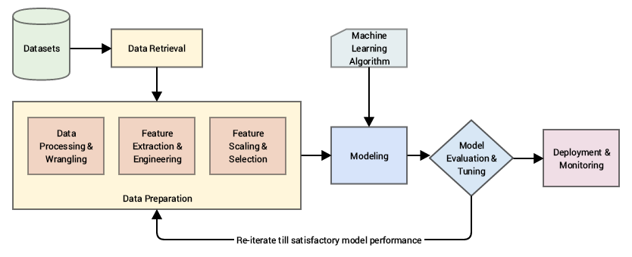
Feature Engineering
Feature Engineering refers to the process of using domain knowledge to select and transform the most relevant variables from raw data and creating some predictive model using ML, the ultimate goal of feature engineering is to improve the performance of machine learning algorithm

Slide 3
Steps of Feature Engineering
EDA
How many Numerical Feature in it
How many categorical Feature in it
Missing Values
Any Outliers in our dataset
Handling Missing Values
Handling Imbalanced Dataset
Treating the Outliers
Scaling down the data
Converting Categorical into Numerical
Benchmarking

Slide 4
Feature Engineering Techniques
Imputation
Handling Outliers
Log Transform
Binning
Feature Split
One hot Encoding

